Slide 1
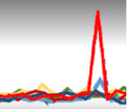
Machine Learning
Artificial Intelligent
Ted Hruzd
NYU Adjunct Instructor
ULL Architectures for ET
SPS Summer 2017 course
PPT for Sessions 2&3
June 6 & 13

Slide 2
Intro
Goals:
Attain working ML/AI knowledge, to enable one to identify use cases & appropriate ML models
Learn Best Practices in order to excel at Time-2-Market with all ML/AI projects and maximize ROI.
Please add:
Survey:
Experience in:
Industries:
Financial Services
Health Care
Pharma
Marketing
Government
Non-Profit
Industrial/Manufacturing
Prospects for ML/AI
FS – ET:
MaxAck (neural networks)
Classify new orders
Pattern Recognition
Alpha Seeking
ML / AI
Neural Networks
Apache Spark or Flink
Tensor Flow
H2o
GPU’s

Slide 3
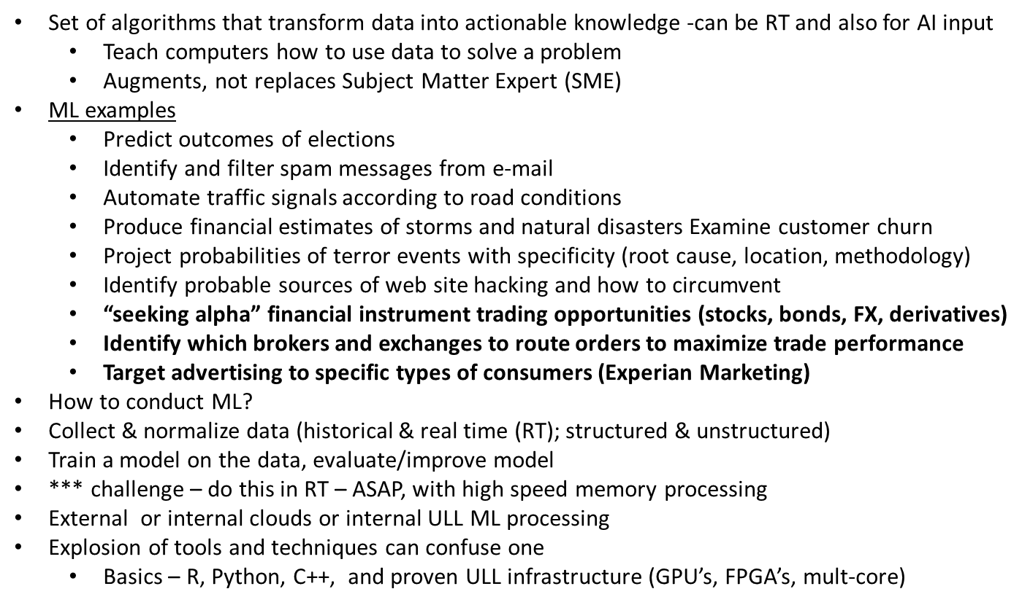
Definition of ML / AI / Deep Learning
ML
←←←

Slide 4
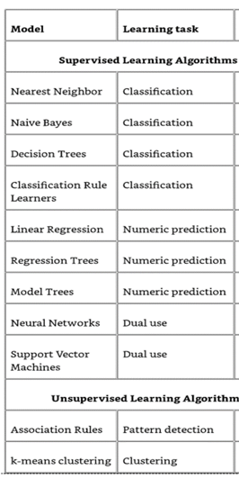
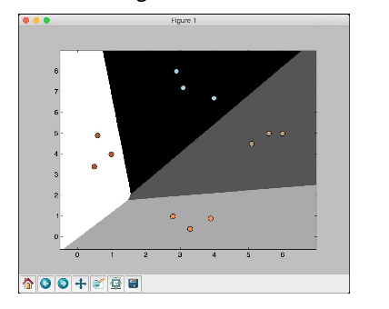
Definition of ML / AI / Deep Learning
Neural Networks (NN) are becoming the most relevant ‘model’ for Deep Learning (DL) & AI
(NN) often involve a data set to predict values for later sets of data.
Algos (Models) to predict outcomes (as output nodes) using input variables (input nodes)
Present the input pattern (data events) to the input nodes.
Then the output pattern is returned from the output nodes.
Supervised have known targets
Classification, numeric predictions, patterns, clustering – very prevalent models
Often components of AI.
Multiple layers for complex neural networks and/or aggregation of multiple neural networks can create a real time, automated, largely unattended AI application.
Unsupervised:
Ex: Buy Side traders
Require custom alpha seeking strategies from Exec Broker
Graph Engines as ML model covered later ….

Slide 5
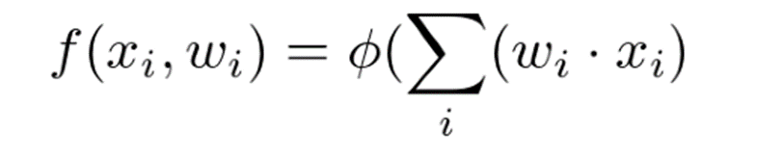
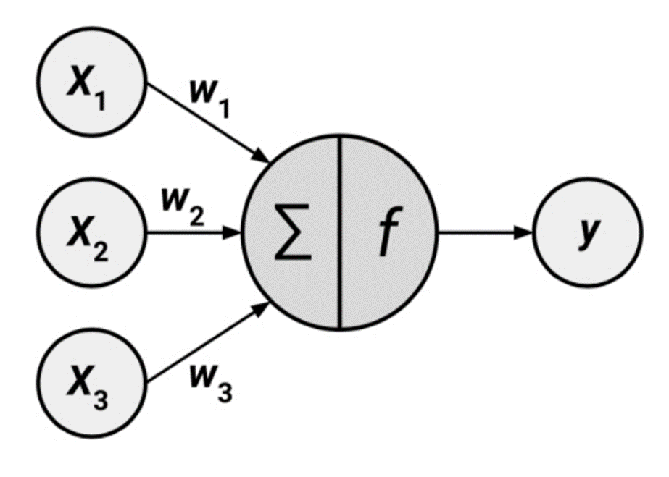
Definition of ML / AI / Deep Learning
NN
How many hidden nodes to use?
can be used to approximate any continuous function to an arbitrary precision over a finite interval.
equation depicted by diagram
NN will generate weights (W’s) for input nodes as part of predictive equation.
Each weight is multiplied by its respective input, and the products of these multiplications are fed into an activation function that is denoted by the Greek letter φ (phi).
rows of data with multiple variables X1, X2, X3, etc predict an outcome Y for future data
Variable weights are calculated with increasing data points
most positive impact on outcome will have greater weights

Slide 6
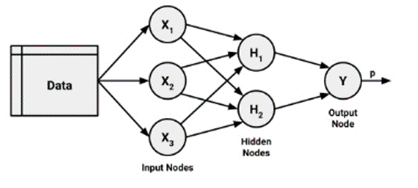
Definition of ML / AI / Deep Learning
More complex networks: additional layers.
Multilayer network adds one or more hidden layers that process the signals from the input nodes prior to it reaching the output node. Most multilayer networks are fully connected, which means that every node in one layer is connected to every node in the next layer, but this is not required.
.
Hidden neurons have two important characteristics. First, hidden neurons only receive input from other neurons, such as input or other hidden neurons. Second, hidden neurons only output to other neurons, such as output or other hidden neurons.
The number of hidden neurons can play a role in model efficiency by decreasing inherent model errors (difference between expected output versus actual);
Also impacting model efficiency are “bias” neurons. Add bias neurons to neural networks to help them learn patterns.

Slide 7
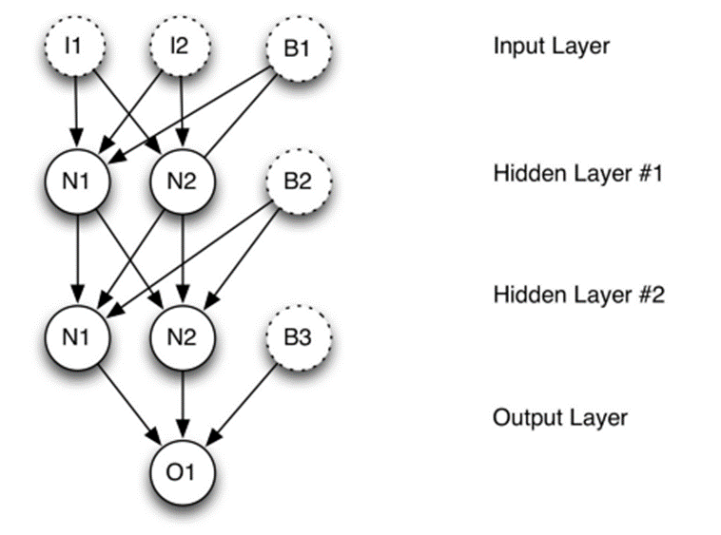
Definition of ML / AI / Deep Learning
Bias neurons are similar to y intercepts in graph projection models.
Shift activation function output
Feedforward networks - input signal is fed continuously in one direction, connection to connection until reaching output layer
extensively applied to real-world problems
Multilayer Perceptron (MLP): de facto standard Artificial Neural Network (ANN) topology
Deep Neural Network (DNN): multiple hidden layers, referred to as deep learning -which may be a major component of AI.

Slide 8
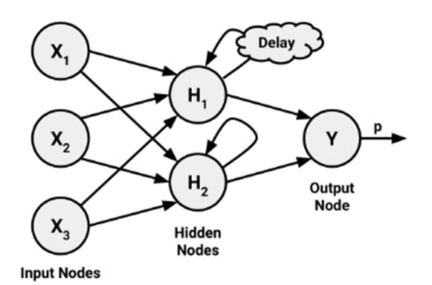
Definition of ML / AI / Deep Learning
Recurrent network (or feedback network) – IBM Watson likely uses this testing hypotheses
More closely mirrors how a biological neural network works,
allows extremely complex patterns to be learned
Capability to understand the sequences of events over a period of time. This could be used for stock market prediction, speech comprehension, or weather forecasting.

Slide 9
Definition of ML / AI / Deep Learning
Creating weights for accurate predictions
Connections between the neurons are strengthened or weakened, similar to how a baby's brain develops as he or she experiences the environment.
Weights: adjusted to reflect the patterns observed over time.
Backpropagation - strategy of back-propagating errors
With each data row iteration (epoch), NN adjusts weights with goal of decreasing model error (difference between observed output versus projected)
CORE of NN
Adjusting connection weights is very computationally intensive – advantage GPU’s!

Slide 10
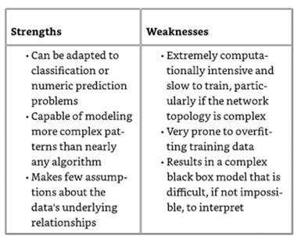
Definition of ML / AI / Deep Learning
Backpropagation strengths & weaknesses:
Backpropagation iterates through many cycles (epochs) of two processes.
NN contains no a priori (existing) knowledge. Hence, starting weights are randomly selected.
Algorithm iterates until a stopping criterion is reached.
How does the algorithm determine how much a weight should be changed? This involves a technique called gradient descent. Conceptually, the algorithm learns to adjust the weights in order to decrease the prediction error (difference between the expected error and observed).
Use of Derivative Calculus; no need understand exact mechanics, just the goal of calculations and resulting actionable insight

Slide 11
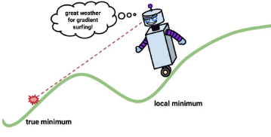
Definition of ML / AI / Deep Learning
More on Gradient Decline
Derivative of each neuron's activation function: gradient suggests how steeply the error will be reduced or increased for a change in the weight.
Algorithm will attempt to change the weights that result in the greatest reduction in error by an amount known as the learning rate. The greater the learning rate, the faster the algorithm will attempt to descend down the gradients, which could reduce the training time at the risk of overshooting the valley.
Error measure: Sum of Squared Errors (SSE),is the sum of the squared predicted minus actual values. A lower SSE implies better predictive performance. This is helpful for estimating the model's performance on the training data, but tells us little about how it will perform on unseen data.

Slide 12
Definition of ML / AI / Deep Learning
DL: fastest-growing field in machine learning.
uses many-layered Deep Neural Networks (DNNs) to learn levels of representation and abstraction that make sense of data such as images, sound, and text.
more than 2 hidden layers
FPGA’s and especially GPU can be really important for DL. It is best to use a DL package that supports it, such as H2O, Theano or Lasagne, or more recently and perhaps the leading tool now – Tensor Flow.
Practical examples include:
Vehicle, pedestrian and landmark identification for driver assistance
Image recognition
Speech recognition and translation
Natural language processing
Life sciences
Accurately predicting “trade” signals in ET (“alpha” seeking strategies) –h2o

Slide 13
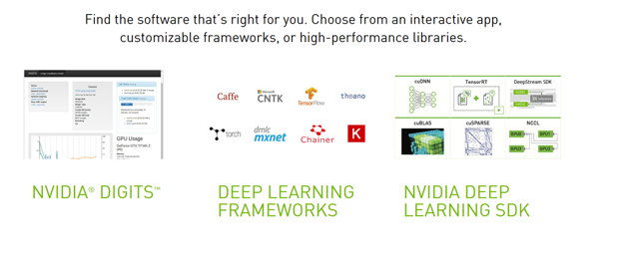
Definition of ML / AI / Deep Learning
The NVIDIA Deep Learning SDK provides high-performance tools and libraries to power innovative GPU-accelerated machine learning applications in the cloud, data centers, workstations, and embedded platforms.
Others are below – how is one to determine which one(s) are right for you? A: –timing in project lifecycle may be factor.
Can we use R/ NeuralNet – yes, but these other software products are more enterprise ready and optimized to take advantage latest high performance and parallel processing (ex: GPU’s)

Slide 14
Definition of ML / AI / Deep Learning
The DL process:
Manage data; train DL models for object or data detection usable in the models
Design/train DL via high level interfaces (ex Tensor Flow)
NVIDIA DL SDK: GPU accelerated & industry vetted DL algo’s
NVIDIA DGX-1 for Analytics with integrated hardware ,(DL SDK), & AI accelerated analytics
OPTION: NVIDIA Docker - Role for Docker containers (ex: feeding, normalizing, analyzing streaming data) Explain how microservices such as Docker containers differ from traditional software
NVLINK for GPU-GPU and GPU-CPU high speed connectivity, with IBM taking advantage of that (Power AI)
TensorFLow on Tesla 100’s
Partnership with Kinetica (in mem with GPU compute)
https://www.nvidia.com/en-us/deep-learning-ai/developer/

Slide 15
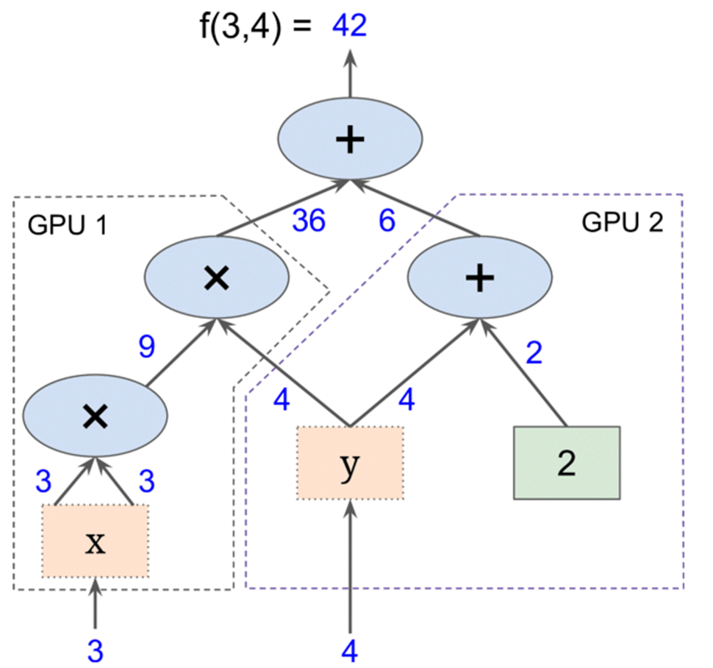
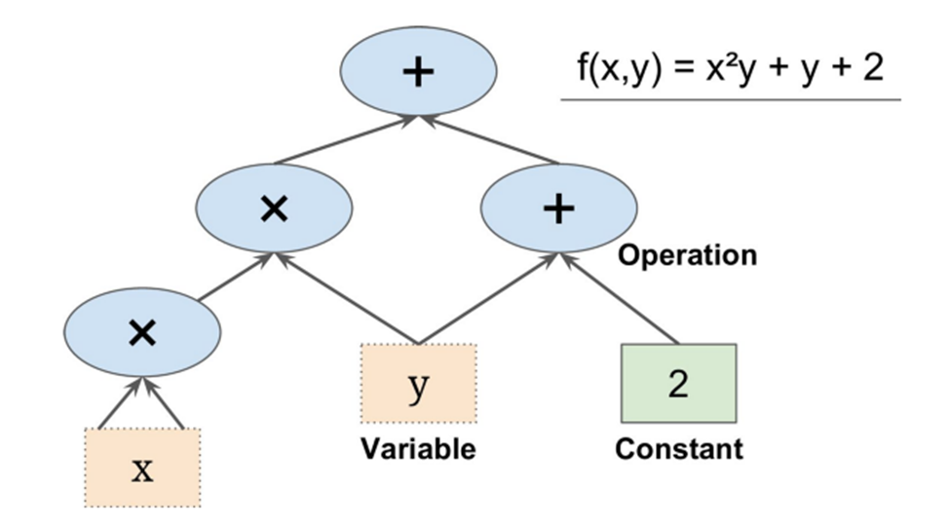
Definition of ML / AI / Deep Learning
TENSOR FLOW BASICS (speeds up processing; will process in parallel; GPUs/FPGA’s
Computation in data flow graphs. Nodes in the graph represent mathematical operations, while the graph edges represent the multidimensional data arrays (tensors) communicated between them.
Flexible architecture allows you to deploy computation to one or more CPUs or GPUs in a desktop, server, or mobile device with a single API.
Process in parallel: →

Slide 16
Definition of ML / AI / Deep Learning
AI is intelligence exhibited by machines. In computer science, the field of AI research defines itself as the study of "intelligent agents": any device that perceives its environment and takes actions that maximize its chance of success at some goal.[1]
Capabilities currently classified as AI include successfully understanding human speech, competing at a high level in strategic gamesystems (such as Chess and Go), self-driving cars, intelligent routing in content delivery networks, and interpreting complex data.
**** Cisco Tetration may be on verge of AI: ---- http://www.cisco.com/c/en/us/products/data-center-analytics/tetration-analytics/index.html (ML for optimal routing in very large networks)
**** LightFleet can argue the same --- http://lightfleet.com/ (optimal routing in multicast networks)
AI often uses neural networks
AI can be set of multiple neural networks that together function, near automatically, solving multiple problems or to accomplish specified tasks.
AI also has a role today for electronic trading

Slide 17
Definition of ML / AI / Deep Learning –FYI Rules v NN
FYI Slide ….. AI usually (1) rules based; (2) ML based
Related to AI is robotic process automation (RPA).
RPA crafts software that automates repetitive tasks (e.g., human data entry)
customer onboarding
procurement processing.
RPA vendors liken the software they create to robots (bots for short).
sophisticated bots can execute rules-based tasks, follow conditional routes, and execute instructions or sequential logic.
More sophisticated RPA platforms can also call upon various machine learning (ML) technologies to add contextual awareness and guidance of unstructured interactions (within, and in support of, business processes) toward desired outcomes.
Vendors with RPA platforms capable of automation based on rules, conditional routing and logical operations (for things like analytics), and that can modify behaviour based on their learnings, stand best odds of success.
RPA is a new birthplace for VC and M&A activity
CHATBOTS: conversation with users. They can be likened to an interactive search engine that returns results based on key words or search terms entered during the chat.

Slide 18
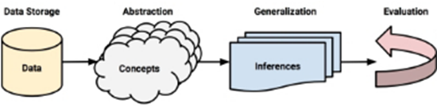
Definition of ML / AI / Deep Learning –FYI Rules v NN
The entire RPA market today, is probably under $100m. However, the value of the productivity gained through RPA use can mount into the billions, making it an exciting market to watch – and for VC’s to invest in.
WorkFusion is based in New York. Its technology was originally developed at MIT for fraud-detection work. Its platform offers drag-and-drop design tooling and comes preloaded with process templates, as well as pre-built robotic, cognitive and exception-handling components to configure custom workflows
RPA vendors seem to be building tools, such as UI’s along with sophisticated software that minimize the skill and effort needed to conduct end-end automation of business tasks.
An AI challenge: Validate multiple automated flows (below) and feed to AI

Slide 19
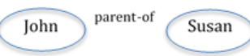
Definition of ML / AI / Deep Learning
Graph Engines for ML
Speeds up causation via links – how one data item or subject relate to other
Simple one:
Graph DB is unstructured – thus EZ quick joins; no schemas
Store data in nodes (vertices) and edges
Interactions can be with many data items
Excellent for pattern matching, filtering
Combine with RDB’s
Use Cases can include verify/predict/prevent cyber attacks, ID drug interactions (LE + Insilico)
Cray is a leading proponent of Graph Engine; has CGE – Cray Graph Engine
http://www.cray.com/products/analytics/cray-graph-engine
Cray use of NVIDIA GPU’s for CGE
GGE: semantic DB using Resource Description Framework (RDF) triples to represent the data, SPARQL as the query language and extensions to support mathematical algorithms.
RDF — Stores each data item as a triple containing a subject-predicate-object. For example, “John is the parent of Susan”:

Slide 20
Use Cases for ML / AI / Deep Learning
** key to many ML Models -ex:
Natural Language Processing (NLP) -- ex: RavenPack – news analytics
Speech Recognition / Translation
Image and Motion Recognition –FIT AI
– translate data to NUMBERS; hence, GPU’s have (had??) advantage

Slide 21
Use Cases: ML / AI / Deep Learning (MEDICAL) -FYI
We can learn much from multiple different industries ML/AI use cases
Cells: cancer or not
Drug interactions (graph engines)
Which Nutritional supplements can cure major diseases
Arginine, Ornithine, Nitric Oxide (endothelium – relax) … Obvious, quick Intelligence
Strength training, BP, ED
AI can Keep You Alive and Healthy - http://www.lifeextension.com/Magazine/2017/4/As-We-See-It/Page-01
What if instead of manually trying to connect every scientific paper that relates to a disease, an artificial intelligence (AI) system read every new biomedical study and then connected those findings with the 10 million existing published studies?
Life Extension (LE) partners with Insilico Medicine to develop nutrient formulas per proprietary AI) to target, neutralize specific pathologies that contribute to degenerative aging. Using graph engines and other ML?
Metformin (anti-diabetic drug approved in England 1958)
LE added it to list of drugs to slow aging in 1995, then @ cancer;
Activates enzyme AMPK, may have been the clue in a graph engine analysis
MORE ……

Slide 22

Use Cases for ML / AI / Deep Learning (MEDICAL) FYI
LE: How many other drugs already exist that, like metformin, have lifesaving mechanisms beyond their “approved” use? We’ve identified dozens since our inception, including low-dose aspirin to protect against cancer and occlusive arterial disease..
Taking it a step further, how many other compounds might be combined with metformin and aspirin to make them work better?
LE: Urgent Need for Deep-Learning AI
A pioneering group called Insilico Medicine has developed a way to dramatically speed up our ability to identify nutrients and drugs that not only attack human aging, but also can be used to treat illnesses like heart disease, cancer, diabetes, and others.

Slide 23
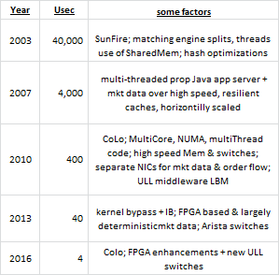
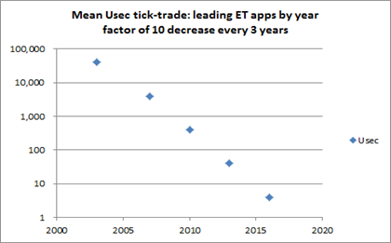
Use Cases for ML / AI / Deep Learning
Max Ack predictions
assess at what level – volume, message rate proportions such as Cancel Replace ratio to Orders impact latencies
ML metrics can determine whether a trading firm is prospering, should stay in ET but needs ROI based infrastructure investments (and for what part of app), or exit the business.
TABB: a large global IB has stated that every ms lost results in $100m per annum in lost opportunity.

Slide 24
Use Cases for ML / AI / Deep Learning
Beware – start-ups via ML/AI can destroy established players. USE CASE: Wealth MGT
Ant Financial
Startups can now rapidly (year or less -even!) can challenge established large players at their prime businesses and sources of income. How – by utilizing latest innovative technologies in ML and AI. Consider Ant Financial:
A start-up with a very disruptive technology and threat to traditional trading firms particularly wealth management. After running payments on trades, it conducted client ML and determined client preferences and possibly what investments were predicted to increase portfolio performance.
In sum, this $4.3 billion funded start-up, off-shoot of Alibaba, automates financial client payments and successfully has branched out to become a promising Wealth Mgt company, in large part due their machine learning models analyzing their customers investment strategies from payments data, thereby alerting clients of specific trade opportunities (soon – our hands on pattern recognition ML model will be input for a specific trade opportunities model)

Slide 25
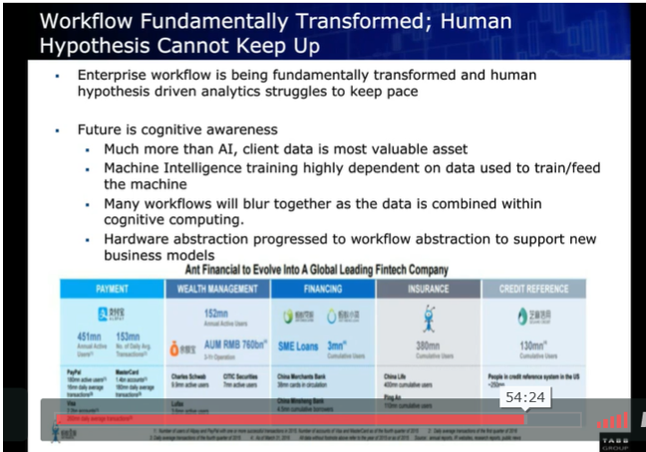
Use Cases for ML / AI / Deep Learning- FYI
FYI
Ant Financial: outstanding prospects!

Slide 26
Use Cases for ML / AI / Deep Learning
TABB FORUM
http://tabbforum.com/videos/next-gen-capital-markets-creating-alpha-through-automation-and-ai
The most valuable asset a company has is the data it keeps from its own trading, along with that of its clients’ trading activity. But many squander this resource. Now, the ability to mine this data through Machine Learning (ML) and Artificial Intelligence (AI) tools is becoming a requirement if banks want to remain competitive.
Compliance & Regulation requirements lead to many data sets that can be aggregated with analytics – with new actionable insights
ex: TX analytics, customer trade patterns: new insights how to trade more profitably
Liquidity & Market Impact
Portfolio updates with RT market data – 100 ms or less
NLP Natural Lang Processing – react to human e-comm + voice communication (convert data to #’s)
Learn from previous algo conditions that resulted in losses and nix those ASAP
TCA analytics to determine whether algo works or not (eval multiple in parallel, in uSecs)
Predict Liquidity in uSecs

Slide 27
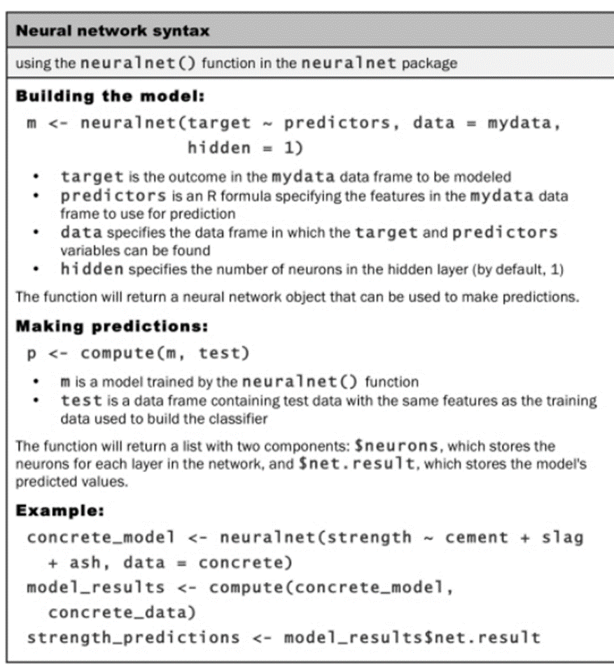
R / Neural Networks
Ted will describe how one can download requisite programming software ( R Studio ) & 3rd party Neural Net library.
Process at right applies to all R/NeuralNet models. This one utilized cement prediction model. I easily tailored this model to ET latency prediction NN.

Slide 28
Infrastructure Best Practices (Quick OverViews)
ML Software & Tools
Apache Spark with Spark ML libraries
Often large clusters of servers are unnecessarily engineered
Diabo-Tech DIMMs 2 TB / server may decrease # servers in cluster
Discuss best practices for Spark
Intel challenging Spark with their ML libraries, add FPGA for speed
Tensor Flow
C++, Java 8 or 9, R, Python
MSFT Azure ML
CEP or ESP
60 East AMPS multi threaded high speed messaging with built in CEP
Apache Storm and also commercial CEP such as from Sybase and SAS
Combine DRAM + Flash via Software Defined Memory (start-up Levyx)

Slide 29
Infrastructure Best Practices
Mellanox – switches & NIC’s
SN2000 series Ethernet switches (with Cumulus Linux)
32 100 GigE ports + 4 adapters
300 ns latencies, zero frame loss, very deterministic (touting their own Asics, not Broadcom)
16 MB buffer – microburst absorption
Congestion Monitoring Event – awareness of location, depth, duration of congestion, works with …. (next)
Cumulus Linux – enables apps to register for & monitor depth (and slow down)
For MultiCast - Drops at slow receiver egress port, allowing fast servers part of MC group to keep running
ConnectX-5 EN NIC (RDMA enabled NIC)
2 – 100 GigE ports
With kernel bypass – sub-600 ns latencies – very deterministic per burst buffer offload and other acceleration features, (may be on par with SolarFlare, or faster now)
Burst Buffer offload (no CPU interference)
Embedded PCIe switch – allows one to build “Machine Learning” appliance
NVMe over Faafric (NVMf) offloads – speed up storage IO
MultiHost technology – multiple hosts can connect into single adapter, separating PCIe interface into multiple interfaces (so no need ToR switch)
High speed SDN with Open V-Switch (OVS) data plane in NIC (not CPU hogging hyperVisor)

Slide 30
Infrastructure Best Practices
Using MRAM from EVERSPIN:
EVERSPIN Enables Low Latency (LL) on reads 6 uS, writes 7 uS via MRAM based nVME storage – much faster and more reliant than traditional SRAM nVME.
https://www.everspin.com/mram-replaces-nvsram
Diablo-tech
vertically scalable DDR4 + Flash memory DIMMs (2 TB) -- to allow very large data sets
Combo of SuperMicro overclocked servers (5 GHz, with superior cooling) result in very appropriate server for ML requiring heavy in-mem processing; Great for sorting
Uses DRAM to front-end all memory reads & writes providing performance & endurance
Diablo Memory Expansion software (DMX) intelligently manages memory access between DRAM & Memory1
Learning engine dynamically profiles application, predicting/prefetching application data

Slide 31
Infrastructure Best Practices
LightFleet (LF)
LF is a start up with intelligent, switchless, routing from source to destination, with near deterministic latencies. Use cases include market data routing and real time Machine Learning (ML). Imagine multiple disparate streams of real time data, whose relevancy is determined by time correlating all metrics for actionable insight (NN).
Light Fleet (LF) - may be a disruptive technology, with promise to improve deterministic latencies for electronic trading. Their “Data Distribution Modules” (switches with FPGA’s for routing)
FPGA’s and GPU’s
GPU’s have been touted for many years (rightly so) as main hardware technology for ML and AI. As most ML needs to be represented in NUMBERS, and often in double precision, GPU’s deep NUMBER processing has been superior to FPGA’s (which excel at data manipulations / transformations). However, the Altera Stratix 10 FPGA outperforms NVIDIA Titan X Pascal GPU when using pruned or compact data types vs full 32 bit floating point data. Reported: https://www.nextplatform.com/2017/03/21/can-fpgas-beat-gpus-accelerating-next-generation-deep-learning/

Slide 32
Infrastructure Best Practices (Reference Only)
Other Vendors /Technologies
OKTAY –FinTech advisory firm
Levyx
Spark and SparkML; Distrib Spark + MPI
CEP / ESP (Real Time – Streaming)
LightFleet
R
Python
Intel PHI MCDRAM
Corvil granular time …
ML prior customer experience
+ similar customer … UI all TX locations
NVLINK GPU GPU and CPU GPU
IBM Power8 ML/DL
Tensor Flow on Cluster NVIDIA Tesla 100 servers
IBM Power AI
Caffee IBMCaffee Theano
Distrib Spark and MPI
HDFS APIs
AWS MLaaS
CRAY – by EOY in Azure -- GPUs
Microservices – streaming data
REST – API GW – Ord/Acct/ etc
Kafka topics
FLINK
TensorRT
NVIDIA DeepStream SDK
CUDO matrix algebra
*** cloud Dev/QA
In mem with GPU compute - Kinetica

Slide 33
Infrastructure Best Practices – Reference Only
TensorFlow
https://blogs.technet.microsoft.com/machinelearning/2017/04/12/embarrassingly-parallel-image-classification-using-cognitive-toolkit-tensorflow-on-azure-hdinsight-spark/
Microsoft’s Cognitive Toolkit (CNTK) and Google’s TensorFlow, can be operationalized for scoring large image collections harbored on Azure Data Lake Store using PySpark.
Building Deep Neural Networks in the Cloud with Azure GPU VMs, MXNet and Microsoft R Server
Applying Deep Learning at Cloud Scale, with Microsoft R Server & Azure Data Lake
Training Deep Neural Networks on ImageNet Using Microsoft R Server and Azure GPU VMs
Cloud-Scale Text Classification with Convolutional Neural Networks on Microsoft Azure

Slide 34
Infrastructure Best Practices – Reference Only
Also -- multiple Docker containers are ideal for handling gamut of streaming data as input to ML
RedHat –tremendous OpenShift progress:
Continues to increase user friendly configurations even new ones such as controlling specific GPU processing for ML models (less need for deep dive Kubernetes expertise)

Slide 35
Present a Case Study: Neural Networks Electronic Trading Latencies
Pt: Equation to predict maximum latencies
Why?
Dark Pool Case
What is a Dark Pool (DP)
DP Traders track their latencies with all Dark Pools & traditional exchanges
DP therefore must track their internal latencies servicing ALL customer
Approx 35% trading not with traditional exchanges

Slide 36
Present a Case Study: Neural Networks Electronic Trading Latencies (from Dark Pool Perspective)
To maximize profits, stay in business, serious trading firms MUST track their ecosystem – trading partners latencies.
Low and deterministic latencies correlate with higher % of fill rates and better prices.
No excuse not to track ecosystem latencies and act on them given today’s technology / Big Data advances
NN Actionable insight per historical and RT data is key
Serious traders know the sell-side, execution brokers, dark pools, & trading venues that exhibit deterministic latencies
Real Time (RT) ML NN identify most reliable partners during high volume peaks
Trade with them especially in volatile times: best $$ opportunities
Trading signals (from ALPHA seeking per Big Data enhancements) have a short life, often in micro seconds.
Best Buy side traders route to the fastest and most deterministic sell side firms.
Investment Banks (IB’s) optimize their dark pools for deterministic latencies (*** our Use Case)
Exec Brokers route to deterministic latency dark pools and lit exchanges
Metrics: significant role -whether trading firm should stay in ET or exit business. (Corvil)
TABB: a large global investment bank has stated that every millisecond lost results in $100m per annum in lost opportunity. (public info to Tabb)

Slide 37
Present a Case Study: Neural Networks Electronic Trading Latencies
Create equation to predict maximum “order Ack Times” to/from a Dark Pool (DP)
Time 0 == application server receives an order internally
TV ( Dark Pool) receives order, acknowledges it, sends it back to application server
Time 1 ==receipt of the above at the application server.
Order Ack == Time 1 – Time 0
Max order times are very important
Best profit making opportunities during spikes
DP aware many customers monitor ecosystem
DP must optimize their app & infrastructure to be top tier
NN will predict MaxAck (output node) with 6 variables (input nodes) with a training set of 400 and test set of 200:
OrdCt
avAck
CxlCt
Cxl.r.Ct
Cxl.to.Ord
CxlR.to.Ord

Slide 38
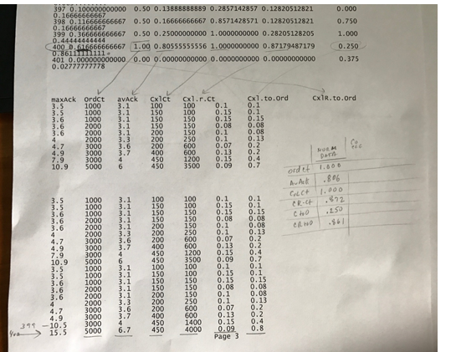
Present a Case Study: Neural Networks Electronic Trading Latencies
Snippet of Data

Slide 39
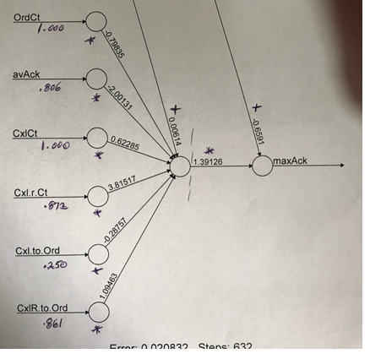
Present a Case Study: Neural Networks Electronic Trading Latencies
Input to Max Ack prediction
For all i:[ [nVal(i)*WT(i)] + B1 ]*H1wt + B2

Slide 40
Present a Case Study: Neural Networks Electronic Trading Latencies
R Code
Normalize the data from 0 to 1 (largest). This simplifies and speeds up our calculations & allows us to proportionally easily assess each input node’s significance.
Concrete_model calculation using neuralnet function provides metrics to create max Ack times equation
Metrics for all input & output nodes are from prior slide (plot).
also includes one hidden node (usually improves accuracy).
To decrease error, difference of actual output (MaxAck) and expected MaxAck, while calculating the data in repeated steeps, the hidden node enhances the process and includes ‘bias’ metrics (similar to y axis intercepts, shifts our output node).
correlation (cor) must be strong (close to 0) -measures how training data and test data correlate.
Low correlation results in inaccurate predicting equation
CODE with OUTPUT NEXT SLIDE (high level details only)

Slide 41
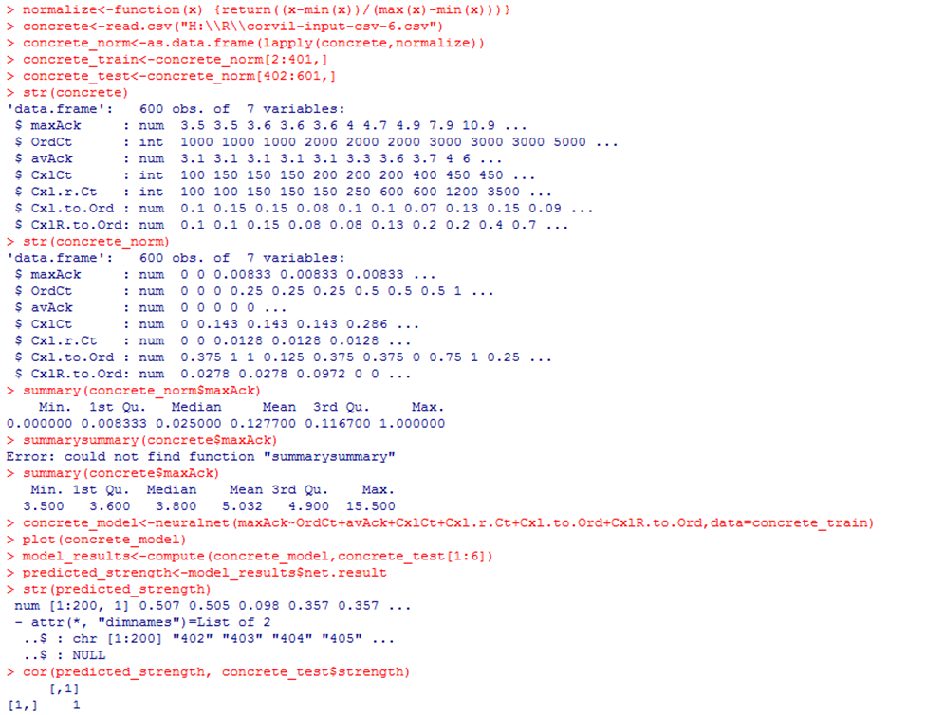
Present a Case Study: Neural Networks Electronic Trading Latencies

Slide 42
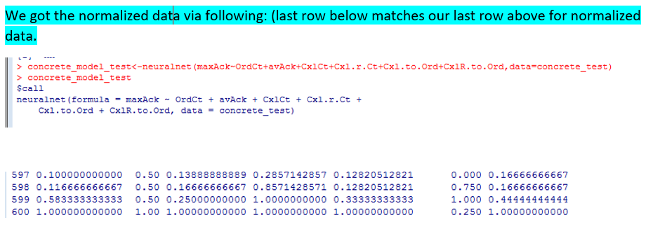
Present a Case Study: Neural Networks Cement Strength

Slide 43
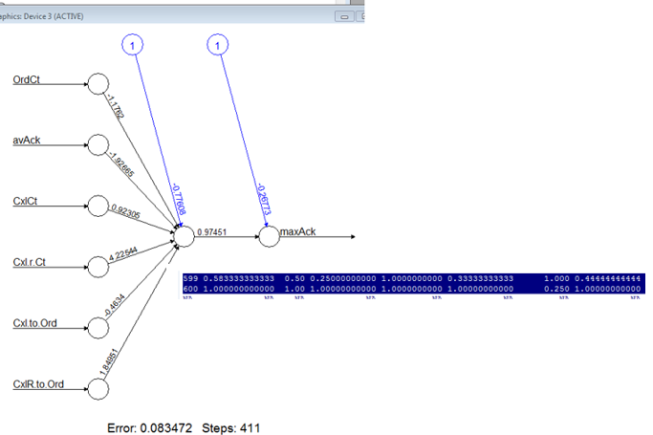
Present a Case Study: Neural Networks Electronic Trading Latencies
plot graphs model with metrics to use for our equation. But what is the equation?
It is to multiply the coefficients of the 6 input nodes on left by the actual normalized data (ex: data from 2 rows below). Sum that and add the first blue ‘bias”. Take this result and multiply that by the # ( 0.97451 2nd graph) between this result and the maxAck node, then add the last ‘bias’. This then is the projected MaxAck per equation.
Next Slide: projection with high # orders

Slide 44
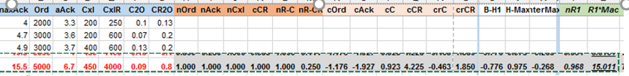
Present a Case Study: Neural Networks Electronic Trading Latencies
1st 7 columns are small subset of actual node #’s. Last row is used for our projection of largest maxAck recorded; We see that the last column, last row predicts a MaxAck of 15.011 (close to actual 15.500). How did we get that?
Multiple input node’s normalized data (prefix of n) * input node’s coefficients (prefix of c). Add 1st bias B-H1 (-.776). Take result and multiply by H-Max (result with hidden node result or .975), add the last bias -.268. nR1 (.968) is the normalized value; proportionally multiply that by the actual observed Max Ack 15.5

Slide 45
Present a Case Study: Deep Learning via H2O Classifying Trading Strategies **** Reference other DOC – NYU-ML-h2o-use-case
CLASS Hands on Exercise:
Purpose: Use an increasingly popular open source tool H2O for Deep Learning – speeds up programming from traditional Python / R but must be integrated with one. We chose R.
Our Use Case: Categorize our trading strategies as:
SB – Strong Buy
B – Buy
N – Neutral
S – Sell Short
SS – Strong Sell Short
6 input nodes (variables) determine each category. The categories (all 5) will be the output nodes (dependent variables).
Ted will explain each variable and how our “training” data were categorized.

Slide 46
Present a Case Study: Deep Learning via H2O Classifying Trading Strategies
Java JRE must be installed – recommend Java 8. Choose the JDK & install
Go to -→ https://www.rstudio.com/products/rstudio/download2/
download, and install it.
Start R (run RStudio), and type install.packages(" h2o").
Also install the file I will send to you: groups-input-csv.csv and groups-input-csv-original.csv
Next: (Ted will explain each step ….)
library( h2o)
h2o.init( nthreads = -1)
> data <-h2o.importFile("H:\\R\\groups-input-csv-original.csv")
> y <-"group"
> x<- setdiff(names(data),y)
> parts <- h2o.splitFrame(data, 0.7)
> train <- parts[[ 1]]
> test <- parts[[ 2]]
> m <- h2o.deeplearning( x, y, train)
> p <- h2o.predict( m, test)

Slide 47
Present a Case Study: Deep Learning via H2O Classifying Trading Strategies
> p
Here is our Output → only 1st 6 by default; get all via > as.data.frame(p))
predict B N S SB SS
1 SB 9.755072e-04 8.424343e-08 3.856824e-14 9.990244e-01 1.894005e-16
2 SS 1.672041e-13 7.191833e-08 2.560162e-03 6.774200e-13 9.974398e-01
3 B 9.867068e-01 6.182144e-03 7.920686e-08 7.110992e-03 3.762406e-12
4 SB 1.126703e-03 2.230613e-07 1.387223e-12 9.988731e-01 1.893214e-14
5 N 1.154476e-03 9.757761e-01 2.306447e-02 2.063789e-06 2.929290e-06
6 N 3.196863e-04 9.986640e-01 1.016343e-03 8.909465e-11 2.274998e-10

Slide 48
Present a Case Study: Deep Learning via H2O Classifying Trading Strategies
> m
Model Details:
==============
.
.
.
MSE: (Extract with `h2o.mse`) 0.0004284974
RMSE: (Extract with `h2o.rmse`) 0.02070018
Logloss: (Extract with `h2o.logloss`) 0.009045752
Mean Per-Class Error: 0
Confusion Matrix: Extract with `h2o.confusionMatrix(<model>,train = TRUE)`)
=========================================================================
Confusion Matrix: vertical: actual; across: predicted
B N S SB SS Error Rate
B 19 0 0 0 0 0.0000 = 0 / 19
N 0 64 0 0 0 0.0000 = 0 / 64
S 0 0 24 0 0 0.0000 = 0 / 24
SB 0 0 0 20 0 0.0000 = 0 / 20
SS 0 0 0 0 16 0.0000 = 0 / 16
Totals 19 64 24 20 16 0.0000 = 0 / 143

Slide 49
Present a Case Study: Deep Learning via H2O Classifying Trading Strategies
> h2o.scoreHistory(m)
Scoring History:
timestamp duration training_speed epochs iterations samples training_rmse training_logloss training_classification_error
1 2017-05-10 15:48:55 0.000 sec 0.00000 0 0.000000
2 2017-05-10 15:48:55 0.141 sec 2979 obs/sec 1.00000 1 143.000000 0.36713 0.80990 0.13287
3 2017-05-10 15:48:55 0.359 sec 5375 obs/sec 10.00000 10 1430.000000 0.02070 0.00905 0.00000

Slide 50
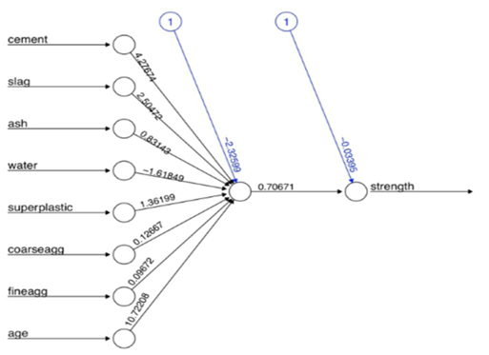
Present a Case Study: Neural Networks- OPTIONAL Cement Strength

Slide 51
Present a Case Study: Neural Networks OPTIONAL Cement Strength
IMPROVE MODEL – 5 hidden nodes:
Networks with more complex topologies are capable of learning more difficult concepts,
add the hidden = 5 parameter: > concrete_model2 <- neuralnet(strength ~ cement + slag + ash + water + superplastic + coarseagg + fineagg + age, data = concrete_train, hidden = 5)
Drastic increase in the number of connections. But this impacted the performance as follows: > plot(concrete_model2)
NEXT SLIDE:

Slide 52
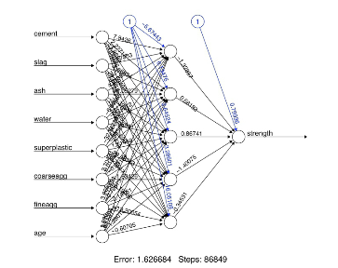
Present a Case Study: Neural Networks OPTIONAL Cement Strength

Slide 53
Present a Case Study: Neural Networks OPTIONAL Cement Strength
Reported error (SSE) reduced from 5.08 in previous model to 1.63 here. # of training steps rose from 4,882 to 86,849, as more complex networks take many more iterations to find the optimal weights. We now obtain a correlation around 0.92, vs previous result of 0.80 with a single hidden node: >
model_results2 <- compute(concrete_model2, concrete_test[1:8])
> predicted_strength2 <- model_results2$net.result
> cor(predicted_strength2, concrete_test$strength)
[,1]
[1,] 0.9244533426

Slide 54
Present a Case Study: Neural Networks Alpha Seeking Strategies ****** SKIM QUICKLY ****
PREP for ALPHA Seeking Proposal: Why is proliferation of real time (RT) data so important to all aspects of Big Data / ML / DL / AI for ? Electronic Trading?
Explosion of RT data requires RT analytics for competitive advantage and regulatory compliance (ex MIFID II, Dodd Frank)
Complex Event Processing (CEP), in 2008-09, ahead of its time, essentially created to attain RT insight, with statistical significance. Some use cases then, and now more prevalent:
RT Alpha seeking & risk analytics for securities trading
Increase in use of ultra low latency (ULL) technologies, as such technologies continue to rapidly improve – great timing for real time ML
GPU’s & FPGA’s
High Speed Memory and caches
Multi core servers
Software design advancements (deep vectors, parallelization)

Slide 55
Present a Case Study: Neural Networks Alpha Seeking Strategies *** Example of (Near) Future use of AI
Consider: DRAW ON BOARD
1st ML - NN: Alpha seeking strategies that provide trading signals for DL per gamut of historical, RT market data, RT news & economics metrics from RavenPack, + fundamental/tech analytics
2nd ML - NN: validated by risk checks (project how long a trading strategy should last, or even start)
3rd NN: routing all orders to the trading venue our latency predicting NN predicts in RT of having both ULL and deterministic latencies, along with high % fill rates and trades (Corvil)
4th- ML -NN: altered/improved in real time by DL predicting trading performance (TCA)
5th ML – Cluster : alerted on compliance issues (which can lead to another NN to predict all market data and trades suspect of compliance issues and immediately dump data to an ML Data Mining task (clear up Compliance issues, resume full trading ASAP)
6th NN: update algo trading in real time per RT events ex: interest rate increases (NN predicting market impact on this variable & others that usually correlate) and per historical insight from special events as Fed announcements, plus client RT changes in trading strategies
The above creates competent, accurate AI – all possible with current technology and if done carefully – very possible with positive ROI.
DL over time perfects AI

Slide 56
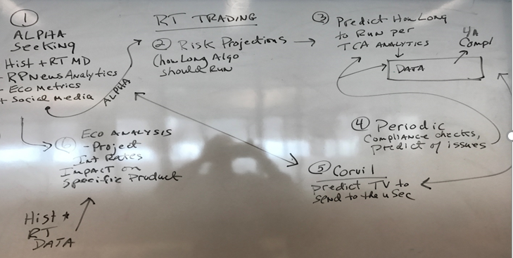
Present a Case Study: Neural Networks Alpha Seeking Strategies
Draft app architecture white board diagram, followed by an Excel sheet

Slide 57
Present a Case Study: Neural Networks Alpha Seeking Strategies
How long to run to protect profit (RISK)
Predict “clusters” of potential problems – for immediate actions, many automated

Slide 58
Present a Case Study: Neural Networks Alpha Seeking Strategies
RT Trading program (multi-threaded, parallelized – Intel cores or FPGA’s), receives multiple signals (over multiple threads), starts new algos on separate threads (or in FPGA).
1st 3 NN’s determine whether a new trading algo should begin.
Note the input and output nodes per NN and the output nodes (decision makers to start/stop). We will start trading with positive PnL metrics from Alpha and Risk NN’s.
The Corvil NN will signal where to route the order flow. The TCA NN will subsequently in RT determine our trade performance (TCA);
if TCA drops under 50 then we will use latest results (our test data) to project where to route our order flow. A TCA under 50 (max of 100, min 0) means that on the average the order execution is at the mid point of initial market data bid/ask spread. There should be a strong TCA correlation with Corvil NN trading venue (TV) recommendation, as the TV’s with most deterministic latencies for the majority of times will have the best TCA. However, TCA is the ultimate check in trading performance.
Finally output from Reg/Comply ML KMeans Clusters will alert of unusual activity which may result in RT trading adjustments (if we have sufficient historical analytics); else data will be dumped quickly for further analysis.

Slide 59
Present a Case Study: Neural Networks Alpha Seeking Strategies
This mimics a live AI application that can deal with $millions every second. In sum it provides an AI example:
IN CONCLUSION -- A powerful example of AI is for a RT trading application to:
function continuously, VIRTUALLY NOT ATTENDED
acting on historical and real time data and alerts,
automatically adjusting its trading activity – all with the goal of maximizing trading profits
with virtually no operations staff mundane / grunt work
allowing operations staff to focus on more analytical and strategic initiatives

Slide 60
AI Innovaton: IBM Watson OPTIONAL
Watson is a question answering (QA) computing system, built on IBM's DeepQA technology
applies advanced natural language processing, information retrieval, knowledge representation, automated reasoning, and machine learning technologies to the field of open domain question answering.
GRAPH ENGINES? QA technology takes a question expressed in natural language, seeks to understand it in much greater detail (than Doc serch), and returns a precise answer to the question.^{[16]}
Per IBM, "more than 100 different techniques are used to analyze natural language, identify sources, find and generate hypotheses, find and score evidence, and merge and rank hypotheses”
Integrates massively parallel IBM POWER7 processors, cluster of 90 IBM Power 750 servers, each at 3.5 GHz POWER7 eight-core processors, 4 threads per core. In total, the system has 2,880 POWER7 processor threads and 16 terabytes of RAM
can process 500 gigabytes, the equivalent of a million books, per second
Jeopardy - all content was stored in Watson's RAM for the Jeopardy game

Slide 61
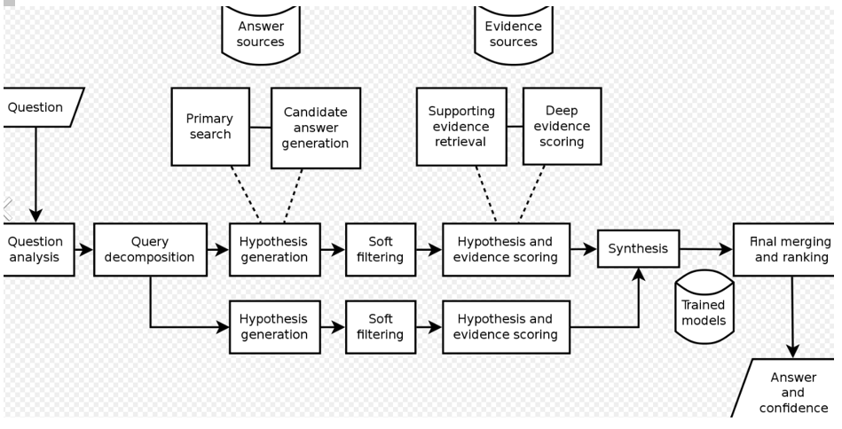
AI Innovaton: IBM Watson OPTIONAL

Slide 62
Machine Learning (ML) & AI Innovaton: FaceBook OPTIONAL
Building 1.5 billion AI agents—one for every person who uses Facebook or any of its products
FBLearner Flow
Combines several ML models, processing several billion data points, per activity of the site’s 1.5 billion users,
NN & pattern Recog & clusters ?
Forms thousands of predictions:
which user is in a photograph, which message is likely to be spam.
define what content appears in your News Feed
what advertisements you see (per your FB usage).
https://research.fb.com/category/facebook-ai-research-fair/

Slide 63
Machine Learning Innovaton: RavenPack
Natural Language Processing (NLP) – proprietary version (used industry experts) lead to multiple news analytics and sentiment analytics for all publicly traded companies (2009)
Ex: fundamental and tech analysis, corporate actions, pure financial, industry group, ratings against competitors, mergers/acquisitions, fines,
Expanded over next few years to FX, Commodities, Economic forecasting
STRONG in trading community
https://www.ravenpack.com/research/browse/

Slide 64
Time to Market
Set up a Pilot internally or externally (with costs in focus).
For internal:
Some providers may be very inexpensive for an internal pilot.
New start ups with new products especially may offer ‘free’ pilots of 30-60 days; this may include shipping hardware, installing software, and participating in the pilot (** I have been there !!)
For external:
Some External cloud and some CoLo providers provide high performance (low latency) infrastructure for ML. This may include low latency networks with GPU’s and FPGA’s (or Intel PHI servers with MCDRAM for multiprocessing and high Speed memory), along with suite of software and MP API’s. Some may feature specific tools with wide range of ML applications such as TensorFlow or distributed Apache Spark with SparkML API’s + MPI support. Alternatively, new real time streaming platform FLINK and high performance joint GPU compute + in-mem processing may be options. Some external providers may include consultants as developers who can speed up development of your use case. Carefully assess an external provider will meet your requirements and negotiate Dev and/or UAT. (Remote access to vendor’s also are excellent way to learn ML and pilot test)
**** SEEK OUT BARE METAL INFRASTRUCTURE IN EXTERNAL CLOUDS
NVIDIA GPUs for deep learning are available in desktops, notebooks, servers, and supercomputers around the world, as well as in cloud services from Amazon, IBM, Microsoft, and Google. You can choose a plug-and-play deep learning solution powered by NVIDIA GPUs or build your own.

Slide 65
Time to Market
Customers developing, QA testing ML/DL on latest GPU’s in external cloud (as pilots), with …
Successful pilots leading to internal clouds with similar infrastructure (with test plan calling for certification of new infrastructure, pending successful pilot – ex: meets ROI) …. Or
Customers developing/testing with GPU in Colo’s, then (pending successful pilot) purchasing GPU infrastructure in Colo for latency sensitive ML (ex: alpha trade signals ASAP to real time CoLo trading applications)
Also -- multiple Docker containers are ideal for handling gamut of streaming data as input to ML
RedHat –tremendous OpenShift progress:
Continues to increase user friendly configurations even new ones such as controlling specific GPU processing for ML models (less need for deep dive Kubernetes expertise)

Slide 66
Conclusion & Take-aways:
This training + additional (see references) will guide you in
identifying ML/DL/AI opportunities, identify models, infrastructure, skillsets,
conduct ROI,
Beat competition via your Time-2-Market plan / implementation
Continue learning – AI on verge of significant and rapid dynamic changes across ET
AI may catapult global economy with greater growth rates than we have witnessed in decades, may exceed Internet Boom.
Be a leader in this space!

Slide 67
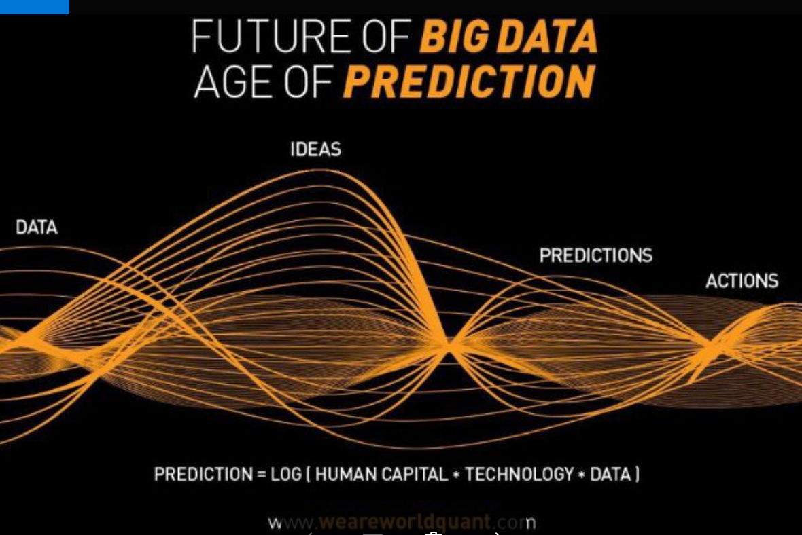
Conclusion & Take-aways:

Slide 68
References / Further Research
3 pertinent and timely texts:
Machine Learning with R – 2nd Edition by Brett Lantz, PACKT Publishers
Hands on with Machine Learning and Tensor Flow by Aurelien Geron, O’Reilly Publishers
AI for Humans, Volume 3: Deep Learning and Neural Networks, by Jeff Heaton
http://www.asimovinstitute.org/neural-network-zoo/
http://searchstorage.techtarget.com/definition/MRAM
http://tabbforum.com/videos/next-gen-capital-markets-creating-alpha-through-automation-and-ai

Slide 69
References / Further Research
https://developer.nvidia.com/deep-learning-software
https://news.developer.nvidia.com/tag/speech-and-audio-processing/
https://devblogs.nvidia.com/parallelforall/introduction-neural-machine-translation-with-gpus/
https://news.developer.nvidia.com/tag/healthcare-and-lifesciences/
https://news.developer.nvidia.com/tag/image-processing/
https://news.developer.nvidia.com/tag/automotive/
https://www.nvidia.com/en-us/deep-learning-ai/developer/
http://www.nvidia.com/object/embedded-systems-dev-kits-modules.html
https://developer.nvidia.com/user
https://www.tensorflow.org/get_started/get_started
https://blogs.technet.microsoft.com/machinelearning/2017/04/12/embarrassingly-parallel-image-classification-using-cognitive-toolkit-tensorflow-on-azure-hdinsight-spark/
https://blogs.technet.microsoft.com/machinelearning/2016/09/15/building-deep-neural-networks-in-the-cloud-with-azure-gpu-vms-mxnet-and-microsoft-r-server/
https://blogs.technet.microsoft.com/machinelearning/2016/10/31/applying-cloud-deep-learning-at-scale-with-microsoft-r-server-azure-data-lake/

Slide 70
References / Further Research
https://blogs.technet.microsoft.com/machinelearning/2016/11/15/imagenet-deep-neural-network-training-using-microsoft-r-server-and-azure-gpu-vms/
https://blogs.technet.microsoft.com/machinelearning/2017/02/13/cloud-scale-text-classification-with-convolutional-neural-networks-on-microsoft-azure/
http://www.mellanox.com/
http://lightfleet.com/
https://www.everspin.com/mram-replaces-nvsram
http://stackoverflow.com/questions/17510098/deriving-equation-by-weights-and-biases-from-a-neural-network
http://www.cray.com/products/analytics

Slide 71
References / Further Research
2 types of AI models: Analytical models (based on human judgment) and Learned models.
Learned: usually complex & accurate, thousands of parameters & very complex math
Supervised learning refers to the process of building a machine learning model that is based on labeled training data. For example, let's say that we want to build a system to automatically predict the income of a person, based on various parameters such as age, education, location, and so on.
Unsupervised: Provide extract insights based on just the data given to you. For example, let's say that we want to build a system where we have to separate a set of data points into multiple groups. The tricky thing here is that we don't know exactly what the criteria of separation should be. Hence, an unsupervised learning algorithm needs to separate the given dataset into a number of groups in the best way possible. ML, classification solves the problem of identifying the category to which a new data point belongs.
whether the given image contains a person's face or not. We would build a training dataset containing classes corresponding to these two classes: face and no-face. We then train the model based on the training samples we have. This trained model is then used for inference.
Ex
BAD TRADE vs GOOD TRADE OR FACE or NOT

Slide 72
EXTRA: Before/After

